Slide 1






FINAL CONFERENCE
Environmental impacts and economic performance for an industrial plant adopting BITMAPS technology
“Pilot technology for aerobic Biodegradation of spent TMAH Photoresist solution in Semiconductor industries – LIFE BITMAPS”
Francesco Vegliò, Full professor (BME)
Department of Industrial and Information Engineering and Economics of the University of L’Aquila, Italy (francesco.veglio@univaq.it )
This Project receives funding form the European Union Life Programm Under Grant Agreement N. LIFE 15 ENV/IT 000332

Slide 2
OUTLINE
The environmental problem targeted market
Life Bitmaps project
Key objectives
Project Technical Results
Planned steps towards the technology
commercialization
Communication and dissemination
Applications of BITMAPS technology
Conclusions

Slide 3

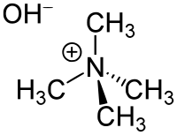


The environmental problem targeted market
A large amount of developer is used by the manufacturing of electronics & semiconductors (E&S) industries.
A high alkaline matter is the main ingredient of developer:
TMAH solutions are usually used.

Slide 4
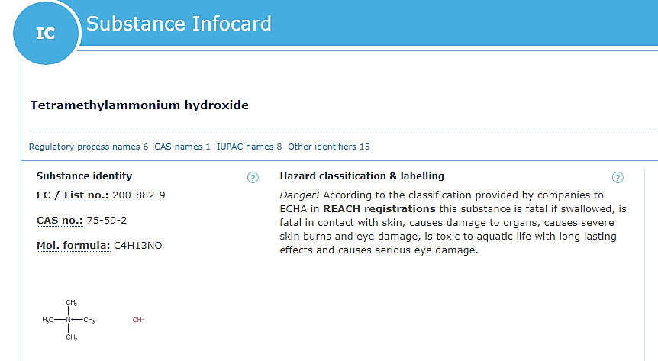

The environmental problem targeted market
This substance is a colorless to light yellow solutions and due to its highly alkalinity and toxic properties, there were several accidents of poisoning and deaths caused by TMAH, which is dangerous also in diluted formulations.
TMAH is also toxic for water environment, the NOEC (No Observed Effect Concentration) to prevent chronic toxic effects on invertebrates (Ceriodphania dubia, Daphnia magna) is 0.02 mg/L.
NO EMISSION LIMIT VALUE (i.e. concentration at discharge) has been set for wastewater containing TMAH by Eu regulation.

Slide 5
The environmental problem targeted market
The Directive 2010/75/EU on industrial emissions and the EU Water Framework Directive 2000/60/EC (annex VIII) provides the list of polluting substances that affects the water quality: among these
“Substance which have an unfavourable influence on the oxygen balance (as. BOD, COD, etc..)” and
“Substance which contribute to eutrophication (in particular nitrates and phosphates)” and TMAH falls under both categories.
As foreseen by the EU Water Framework Directive 2000/06/EC and taking into account other considerations, Istituto Superiore di Sanità recommend to keep the discharge limits below 0.4 mg/L in the drainage system and to ensure 0.2 mg/L thresholds in water bodies.

Slide 6
The environmental problem targeted market
Regional Agency for the Enviromental Protection of Abruzzo region has transposed the techincal note of ISS and recomended LFoundry to investigate viable solutions for reduction the TMAH concentration on its plant.
THE PROBLEM IS CLEARLY OF EUROPEAN RELEVANCE
Many industries synthetize and use TMAH
250,000 tons/years of diluted TMAH solutions are used (data estimated for European market)
Advanced treatment of this kind of wastewaters process solutions represent a key challenge for the European E&S industries that must be improved for safeguard of surface and groundwater quality.

Slide 7
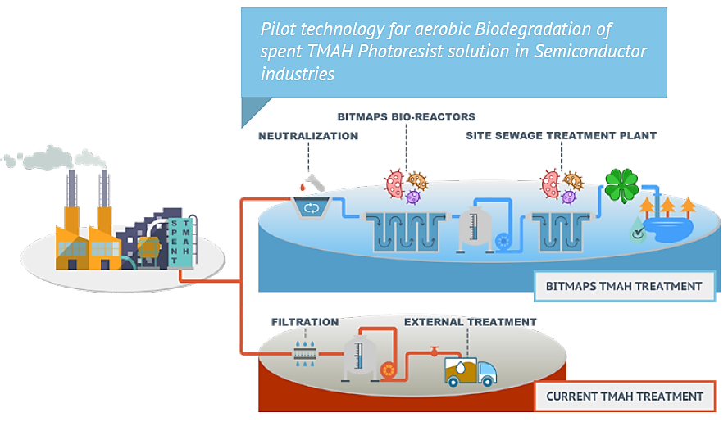
Life Bitmaps project

Slide 8

BITMAPS CONSORTIUM

Slide 9
KEY OBJECTIVES
Design, construction and validation of a semi-industrial pilot plant enabling the treatment of spent photoresist-tetramethylammonium hydroxide (PR/TMAH), and other mixed solutions (ammonium fluoride and acid mix internally named “SEZ”) generated by the semiconductor manufacturing processes.
Demonstrate, at industrial scale, the feasibility/sustainability for TMAH treatment through an aerobic biodegradation of such toxic substance carried out by adapted microorganisms selected during the R&D phase.
Prove the cost sustainability of the process, in a LCC perspective, also taking into account the actual annual operating costs for the disposal of concentrated TMAH and the other waste solutions.
Pave the way for replication and transfer of the results to E&S Sector.
Propose new quality standards for wastewater discharged helping policy-makers to fill the regulatory gaps on TMAH emissions

Slide 10
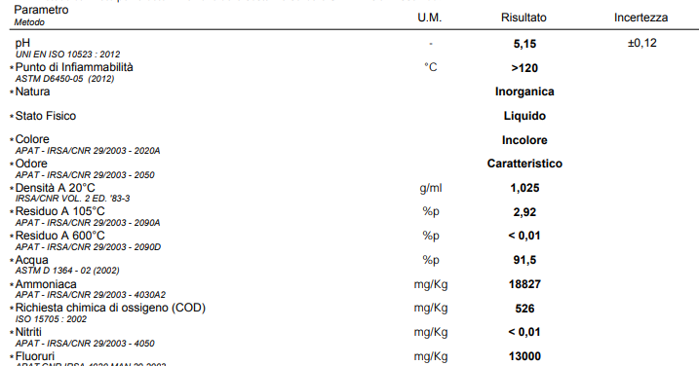
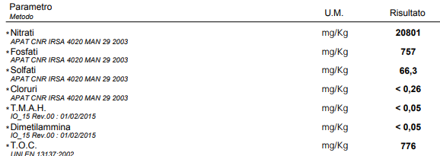
KEY OBJECTIVES
Besides the TMAH treatment, it has been decided to verify the possibility to treat some selected spent solutions
BOE and SEZ having high concentration of pollutants (i.e. fluoirdes, inorganic and organic acid) with the aim to reduce their toxicity and to manage the streams sending them to the wastewater treatment plant already operating on the industrial site in FLoundry
BOE
CER 110111* aqueous rinsing liquids containing dangerous substances

Slide 11
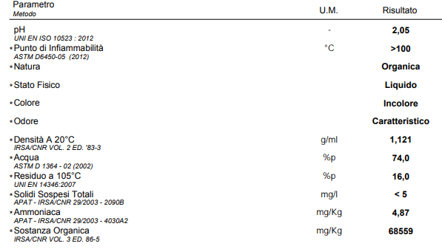
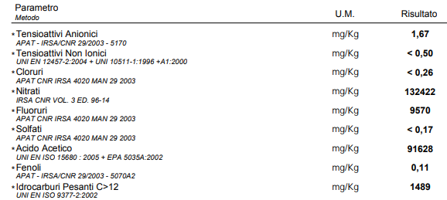
KEY OBJECTIVES
SEZ
CER 110111* aqueous rinsing liquids containing dangerous substances
For BOE and SEZ has been proposed a chemical precipitation by adding lime and a coagulant

Slide 12
PROJECT RESULTS
PROJECT TECHNICAL RESULTS

Slide 13
Project technical results
Preliminary research activity – lab scale tests
Design and construction of pilot plant
Experimental results of biooxidation of TMAH
Experimental results of chemical precipitation (SEZ, BoE)
Process analysis and Industrial Plant Design
Preliminary Economical Analysis and LCA

Slide 14
Lab-scale tests: LIFE BITMAPS
Biological tests carried out in a lab-scale bioreactor: TMAH degradation

Slide 15
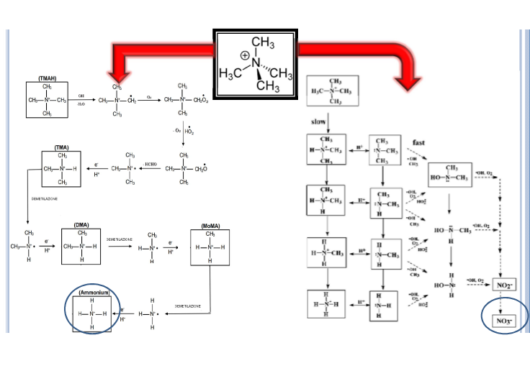
Mechanism of biodegradation of TMAH

Slide 16
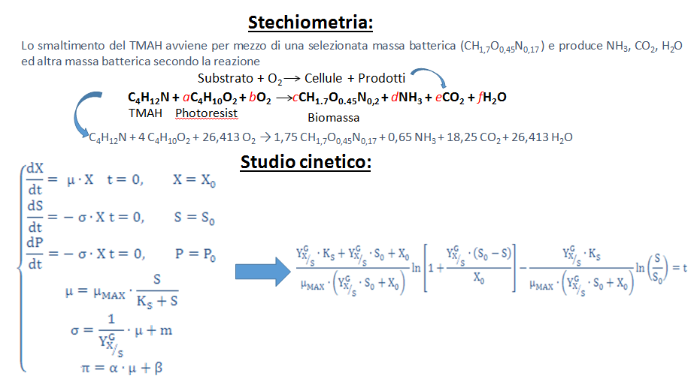
Stoichiometry and Kinetic model of TMAH biodegradation
Mathematical modelling of the stoichiometry and kinetic of TMAH biodegradation: analysis of lab-scale bioreactor tests

Slide 17
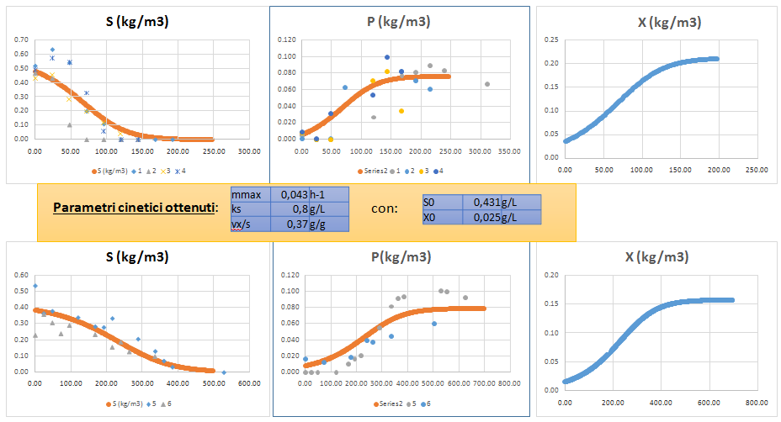
Data fitting of kinetic model of TMAH biodegradation
Experimental results of biodegradation tests in lab-scale and mathematical modelling
(S = TMAH; O = NH4+; X = biomass concentration)

Slide 18
Main conclusions of lab-scale tests
Conclusions of the lab-scale tests :
TMAH can be biodegraded after biomass adaptation: stoichiometry and kinetic model identified;
The biodegradation produce NH4+ as a by-product (without nitrification);
3. The kinetic model gives indication that bioreactors in series is a suitable solution to reduce the volumes of bioreactors;
THIS PROCESS SOLUTION HAS BEEN SELECTED TO REALIZE THE PILOT PLANT

Slide 19
LIFE BITMAPS: chemical precipitation BoE-SEZ
Chemical composition of BoE and SEZ
Wastewater | pH | Si, mg/L | F⁻, mg/L | PO₄³⁻, mg/L | NH₄⁻, mg/L | NO₃, mg/L | COD, mg/L | CН₃СООН, mg/L | Anionic surfactants, mg/L
NH4F-BoE | 8.75 | 23.5 | 20,100 | 1,450 | 25,700 | 977 | 500 | - | 0
SEZ | 1.6 | 314 | 16,861 | - | - | 119,048 | 109,000 | 26,112 | 23.8

Slide 20
LIFE BITMAPS: chemical precipitation BoE-SEZ
Chemical reactions of BoE and SEZ
6 Al₂(SO₄)₃ (18 H₂O) + 9 Ca(OH)₂ → 18 Ca₂(SO₄)₃↓ + 4 Al(OH)₂
2 HNO₃ + Ca(OH)₂ → Ca(NO₃)₂ +2 H₂O
2 NH₄F + Ca(OH)₂ → CaF₂↓ + 2 NH₄OH NH₄OH → NH₃ + H₂O
2 H₃PO₄ + 3 Ca(OH)₂ → Ca₃(PO₄)₂ ↓ + 6 H₂O
BoE
2 HNO₃ + Ca(OH)₂ → Ca(NO₃)₂ +2 H₂O
2 HF + Ca(OH)₂ → CaF₂↓ + 2 H₂O
2CH₃COOH + Ca(OH)₂ → Ca(CH₃COO)₂ + 2H₂O
SEZ

Slide 21
LIFE BITMAPS: chemical precipitation BoE-SEZ
Chemical composition of wastewater after treatment
Wastewater | pH | Si, mg/L | F⁻, mg/L | PO₄³⁻, mg/L | NH₄⁻, mg/L | NO₃, mg/L | COD, mg/L | CН₃СООН, mg/L | Anionic surfactants, mg/L
NH₄F | 11 | 0.4 | 8 | 0 | 13,300 | 977 | 100 | - | 0
SEZ | 4.7 | 0.4 | 11 | 0 | - | 119,048 | 73,400 | 26,112 | 14.0
Consumption of reagents (to be optimized)
Wastewater | Al₂(SO₄)₃ kg/m³ | Ca(OH)₂ 20% kg/m³
NH4F | 40 | 364
SEZ | 0 | 580

Slide 22
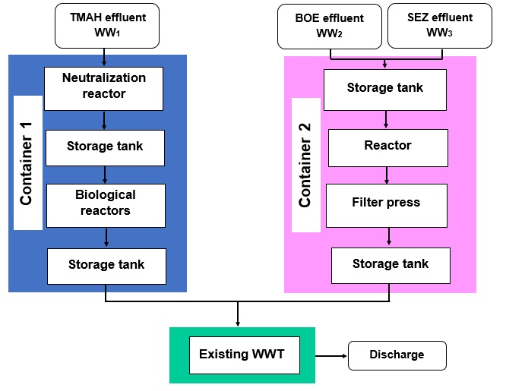
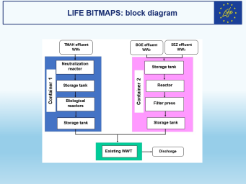

LIFE BITMAPS: block diagram

Slide 23
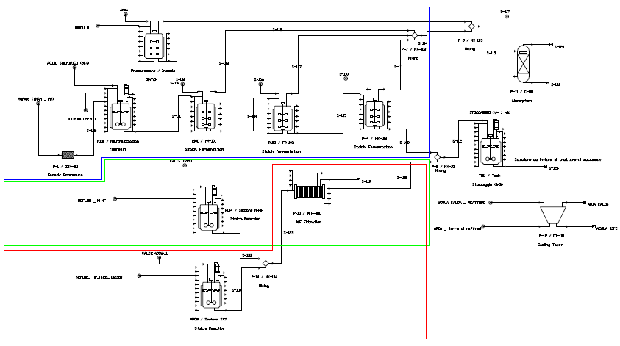
LIFE BITMAPS: flowsheet and process design
TMAH + PR
WWT
BoE
SEZ

Slide 24
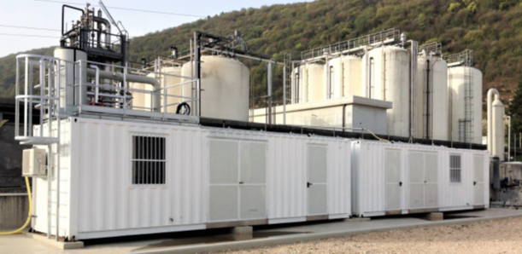
THE PILOT PLANT
The treatment sections of the plant assembled inside two
aligned containers (30 ft. each placed on a concrete and
chemical proof platform to prevent any possible subsoil
contamination in case of leakages) and connected with
an external scrubber for the abatement of air emissions.
TMAH directly fed from the site collecting tank of that waste, whereas ammonium fluoride and acid mix wastewaters are automatically transferred by the operator from drums inside the dedicated section of the plant.
The first container includes the biological section made by three reactors operating in sequence to accelerate the TMAH degradation. This section can be operated for a wide range of TMAH input flows.
The other container hosts a chemical-physical section including a reactor and a small filter-press.
All the volatile substances generated with treatments are captured and conveyed to the scrubber in order to minimize air emissions.
The output liquid streams from the two treatment sections are collected and discharged to the site biological wastewater treatment plant.

Slide 25
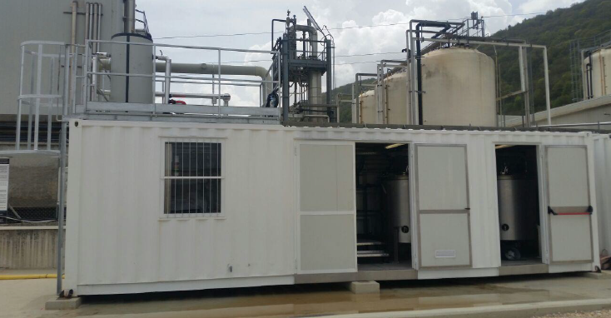
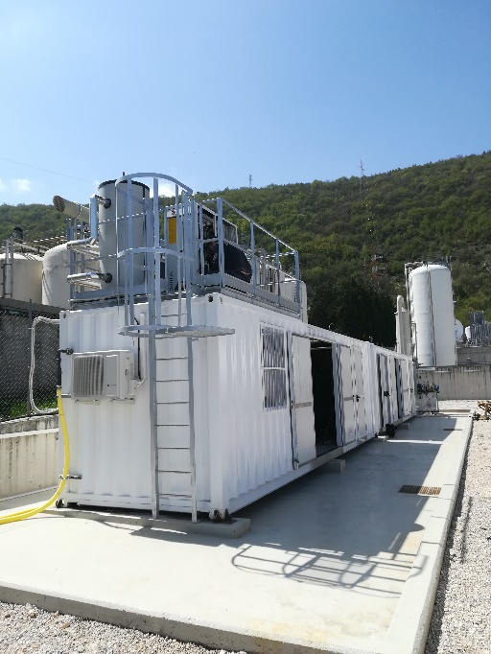
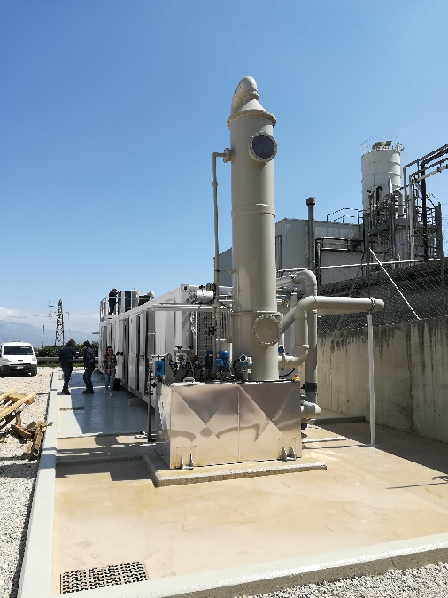
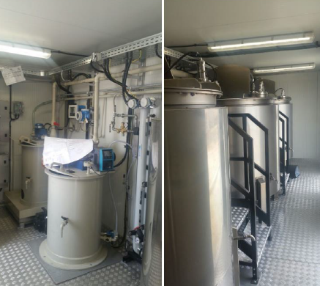
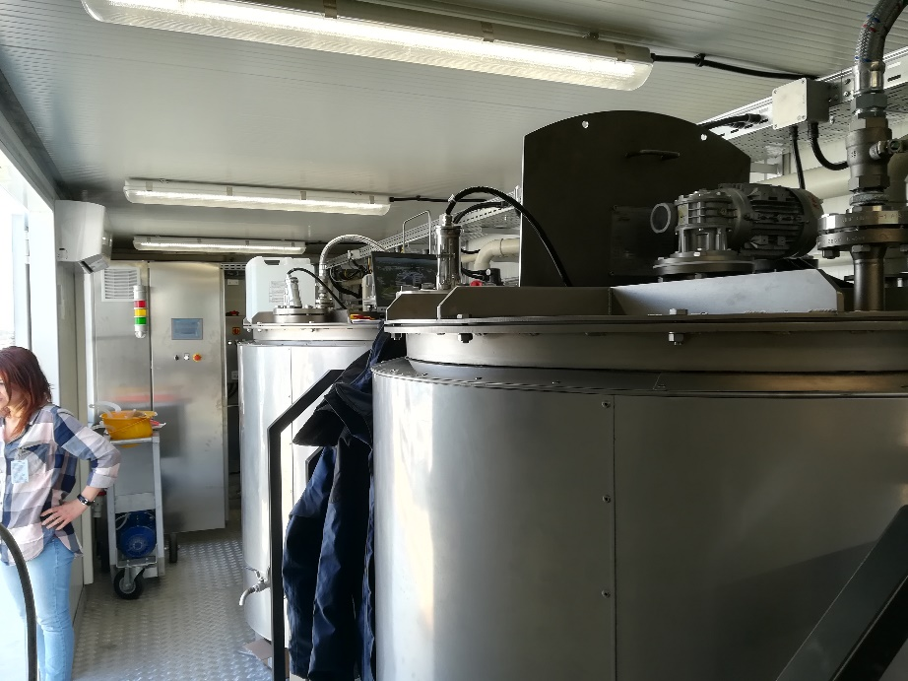
LIFE BITMAPS: pilot plant – Container 1
General overview of the mobile pilot plant
Neutralization of TMAH and N°3 bio-reactors in series

Slide 26
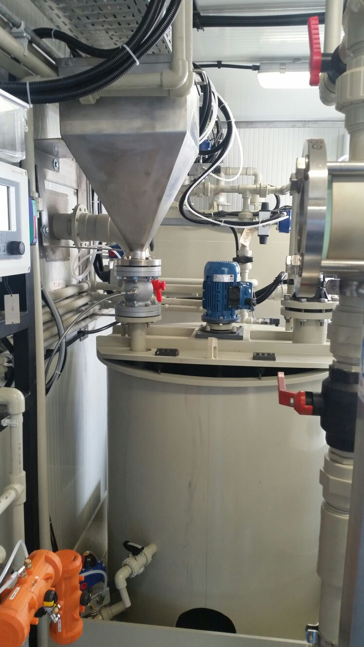
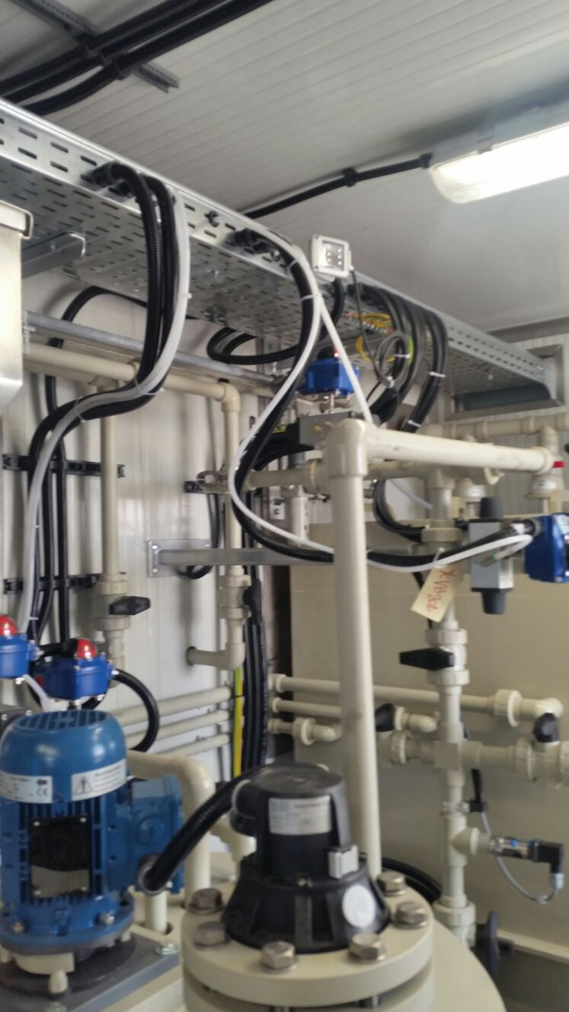
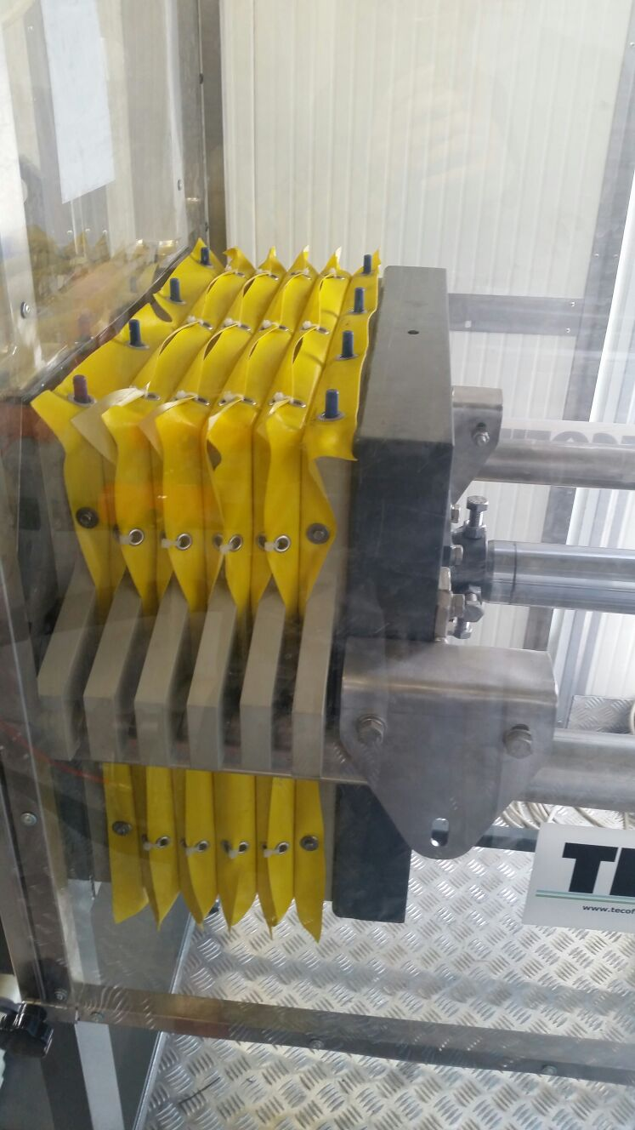
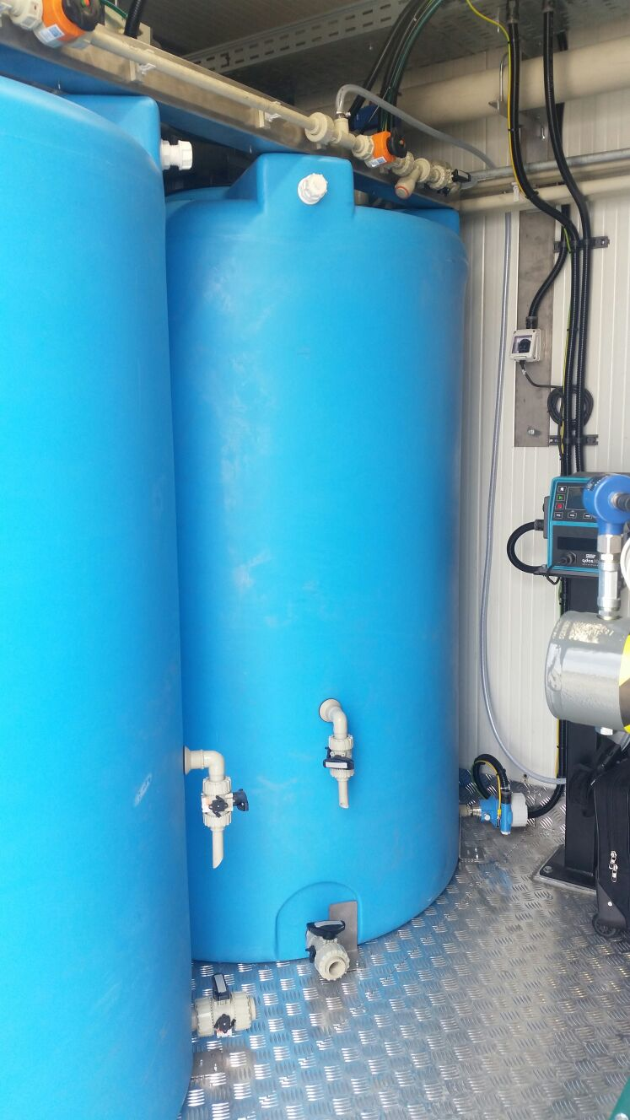
LIFE BITMAPS: pilot plant – Container 2
Container for the treatment of BoE and SEZ

Slide 27
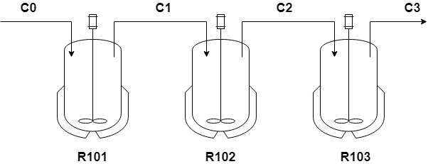
LIFE BITMAPS: pilot plant biological tests
Time [h] | R101 | R102 | R013
48 | 7.53% | 45.10% | 55.38%
168 | 61.46% | 96.47% | 99.97%
192 | 55.48% | 90.82% | 99.02%
TMAH biodegradation yield (5 L/h of neutralized feed as-is)

Slide 28
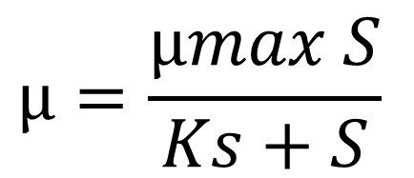
LIFE BITMAPS: data analysis of biological tests
Parameters of Monod model:
μmax = 0,012 h-1
Ks = 250 mg/L
$$µ=\frac{µmax S}{Ks+S}$$

Slide 29
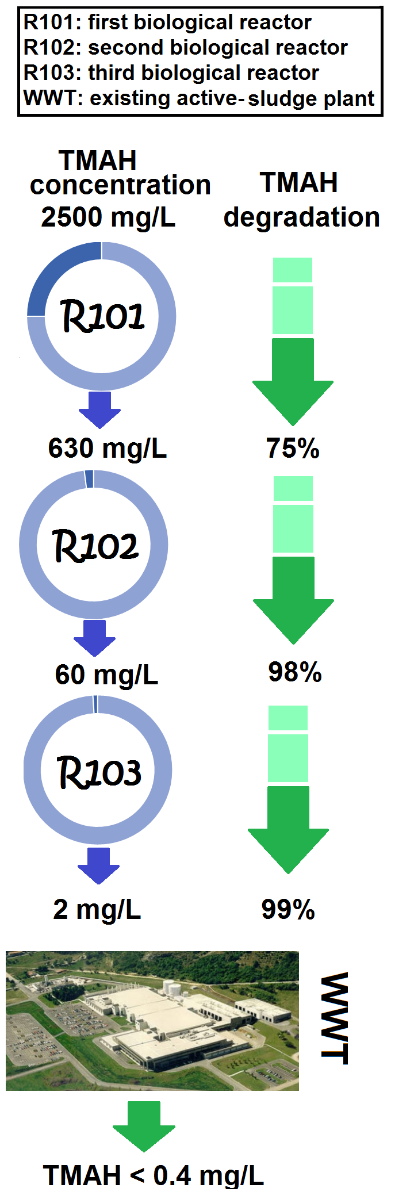
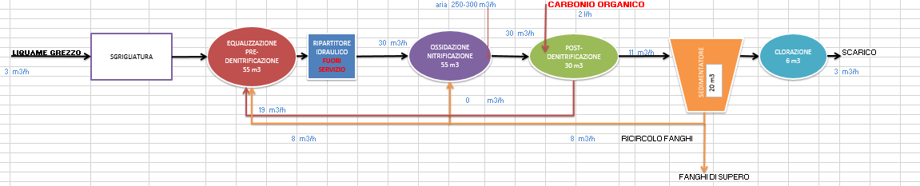
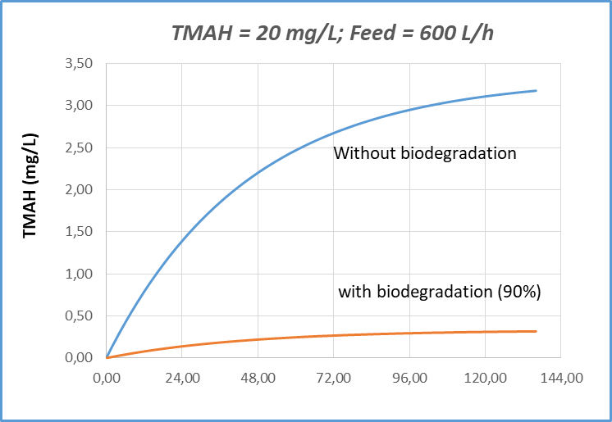
LIFE BITMAPS: biological tests on WWT plants
Test in real scale

Slide 30
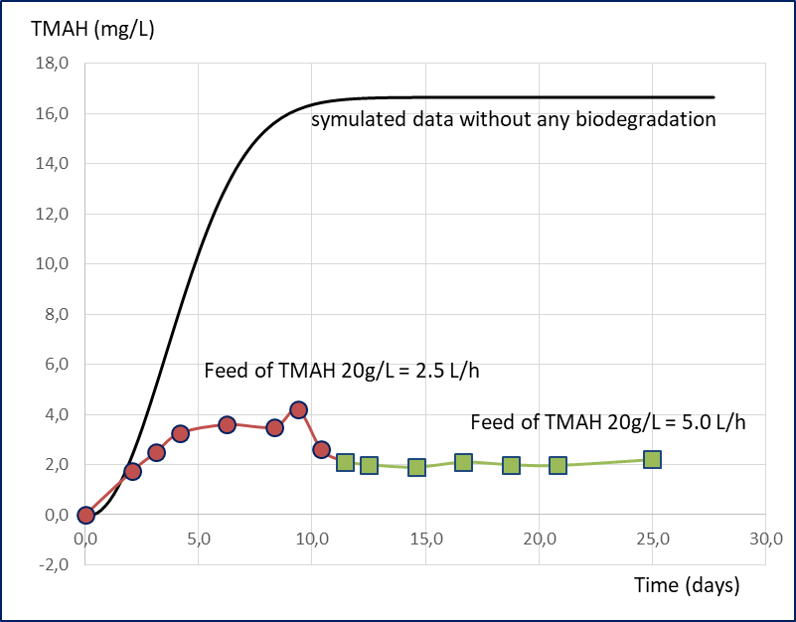
Feeding residual TMAH to the existing WWT
Residual TMAH was fed to the WWT (active sludge process): in the figure the experimental results in terms of TMAH at the exit of WWT is compared with simulated data (CSTR model without biochemical reaction).

Slide 31
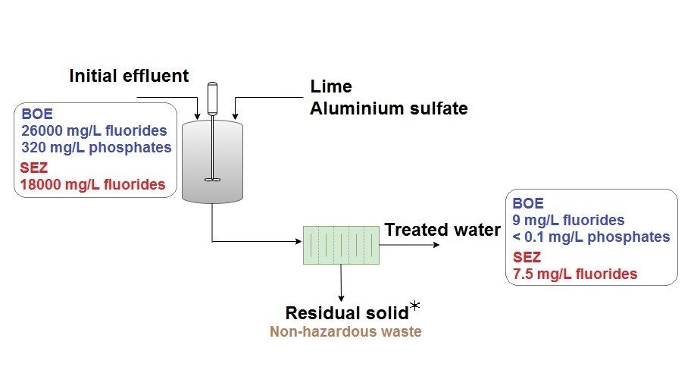
LIFE BITMAPS: data analysis of chemical tests

Slide 32
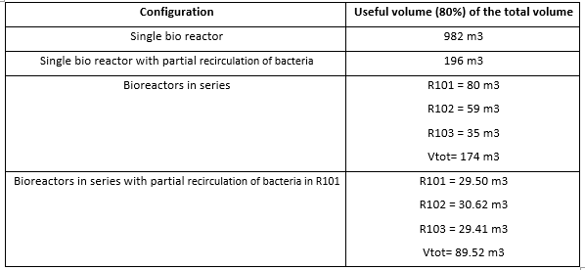
LIFE BITMAPS: Industrial Plant Design 1/2
Optimal configuration

Slide 33
LIFE BITMAPS: lay-out

Slide 34
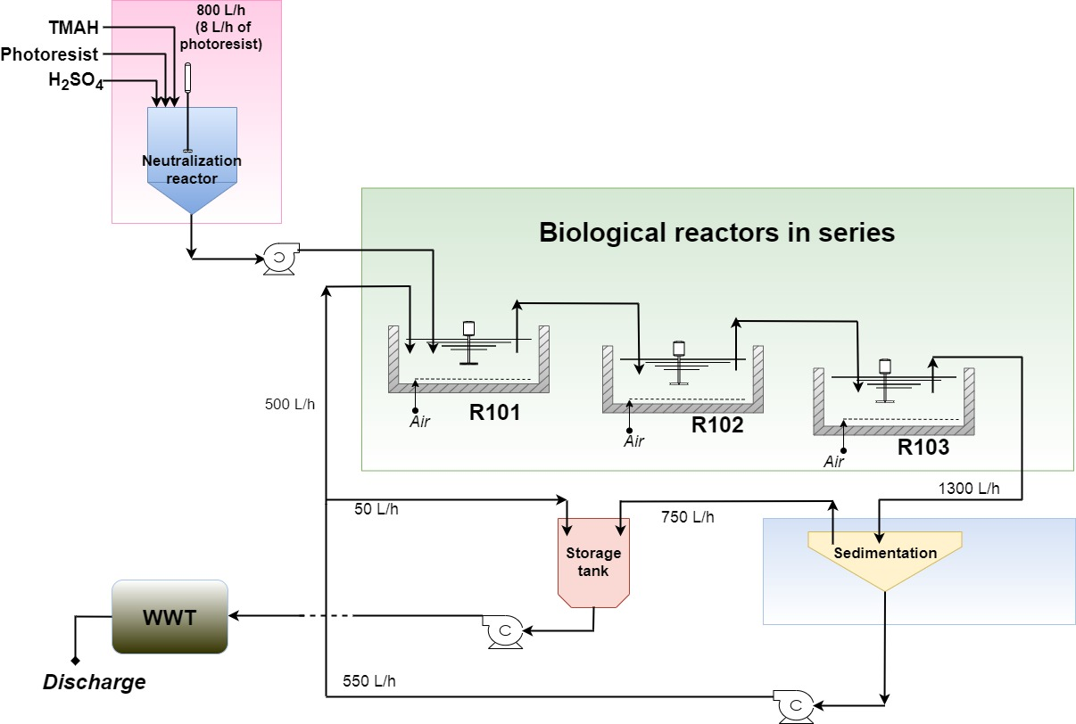
M&E balance + Business case
V R101 = V R102 = V R103 = 30 m3

Slide 35
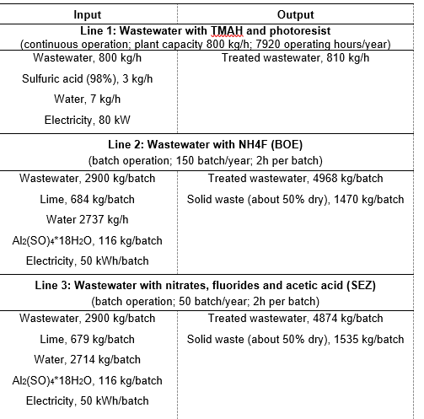
M&E balance + Business case

Slide 36
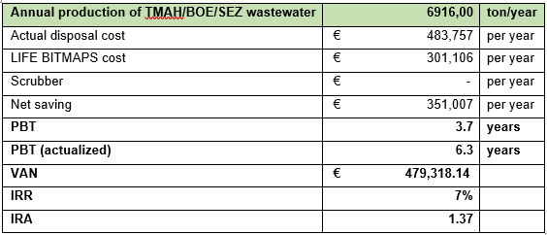
LIFE BITMAPS: preliminary economical feasibility

Slide 37
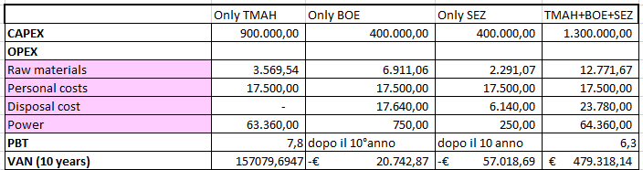
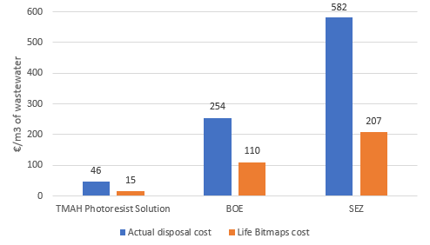
LIFE BITMAPS: preliminary economical feasibility

Slide 38
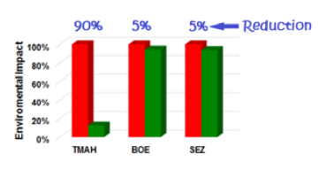
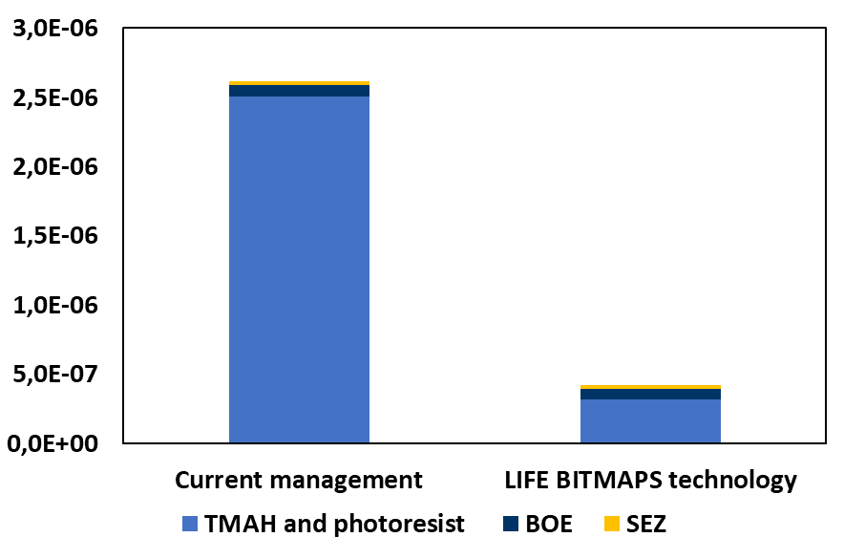
LCA results: comparison of “environmental index” before
and after LIFE project

Slide 39
Action B5 – Report on planned steps towards the technology commercialization by BFC

Slide 40
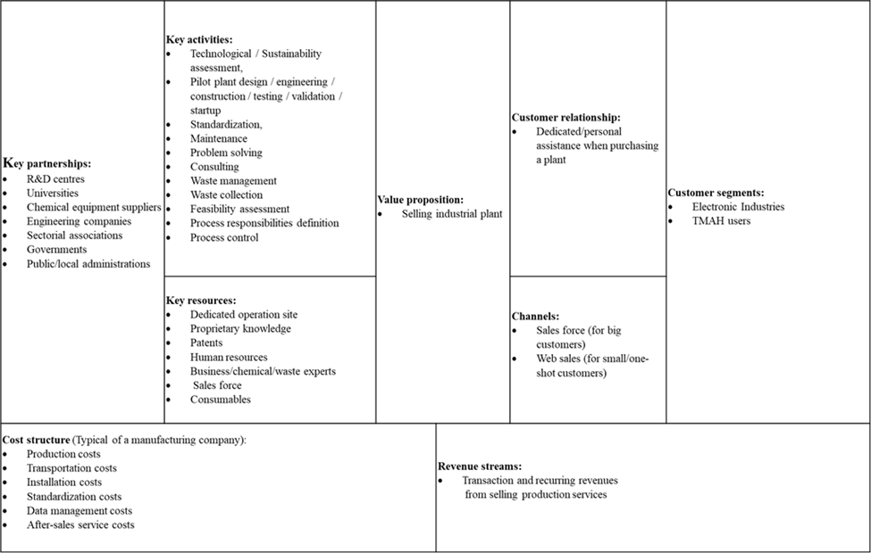
Action B5 – Report on planned steps towards the technology commercialization by BFC: Business Model (Canvas)

Slide 41
Action B5 – Report on planned steps towards the technology commercialization by BFC: SWOT

Slide 42
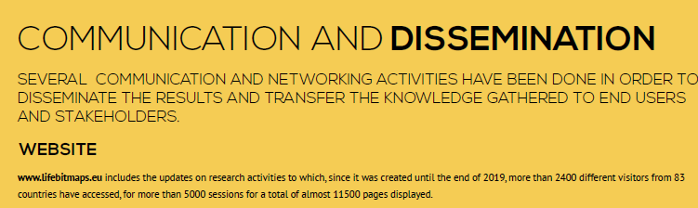
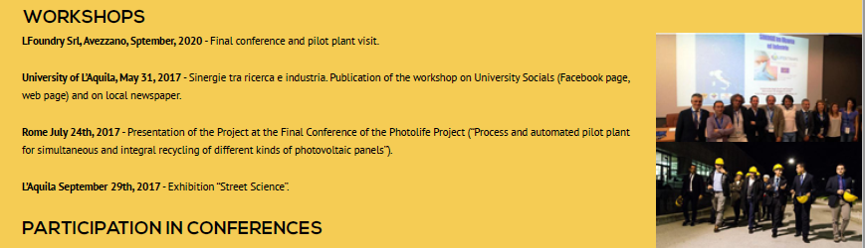

Slide 43
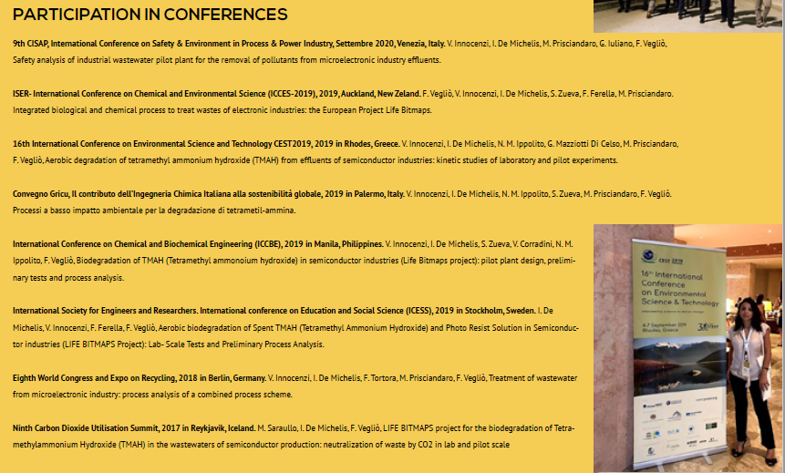
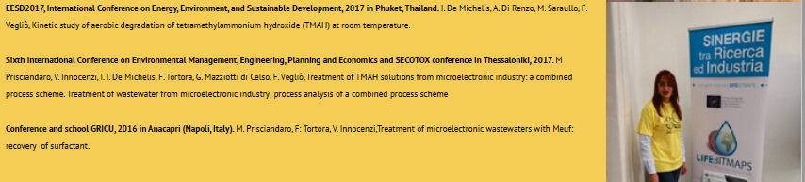

Slide 44
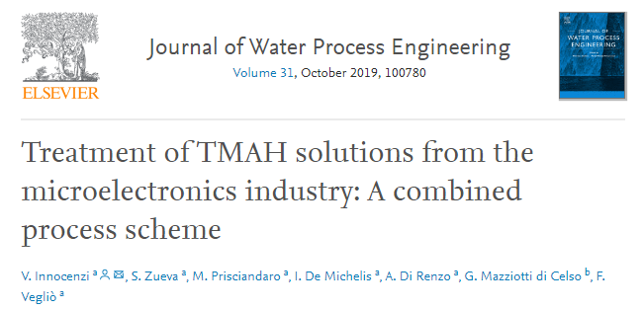
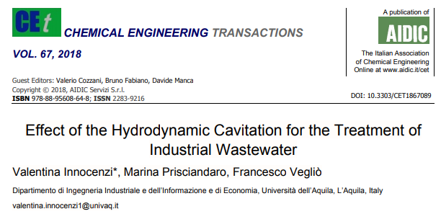
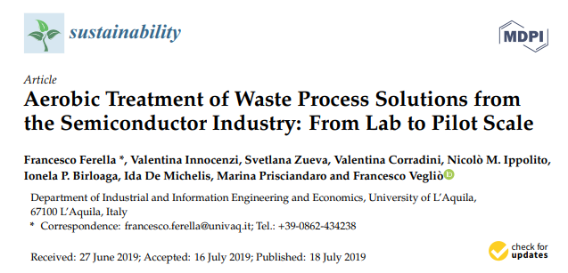

Slide 45
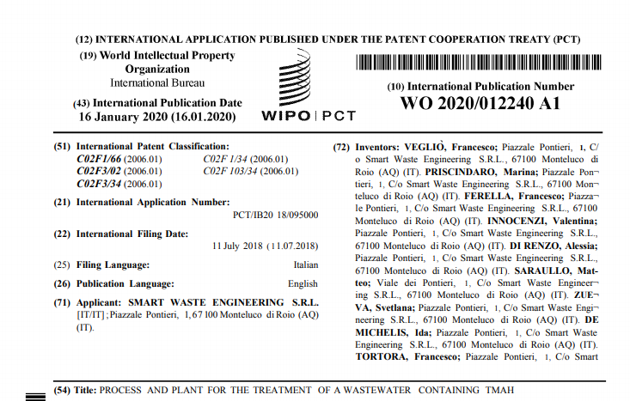
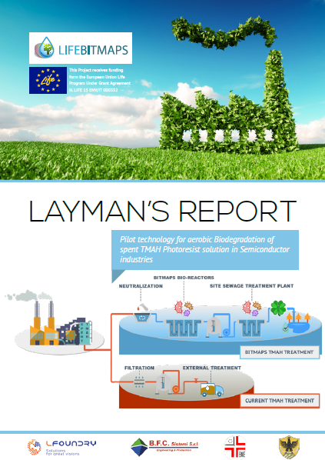
Patent and Layman report

Slide 46
Applications of BIMAPS technology
TMAH as a waste (LIFE BITMAPS)
TMAH in washing waters (RO + LIFE BITMAPS)
Co-processing with other wastewaters/wastes (i.e. BoE, SEZ)
TMAH recovery for low grade application + LIFE BITMAPS
Exploitation of LIFE BITMAPS wastes (i.e. CaF)
Possible other applications of TMAH wastes (in progress)

Slide 47


LIFE BITMAPS: Conclusions
Main conclusions
TMAH biodegradation with nitrification process was demonstrated;
Chemical treatment BoE and SEZ was demonstrated;
Pilot plant’s technical problems highlighted and resolved;
Integration of this process with WWT was demonstrated;
Preliminary design of treatment in industrial scale;
Economical evaluation
Customized solutions;
LCA and LCC analysis
Business model and post-BITMAPS exploitation
Proposed technology as BAT

Slide 48




Thank You very much for your attention !
BITMAPS website: http://www.lifebitmaps.eu/
This Project receives funding form the European Union Life Programme Under Grant Agreement N. LIFE 15 ENV/IT 000332.

